Slide 1
Data Science and Engineering Tools - INFO6105
ENHANCING HOSPITALITY PREDICTIONS: ANALYZING MODEL PERFORMANCE AND SELECTION FOR HOTEL BOOKING DATA

Slide 2
LET'S BEGIN!

Slide 3
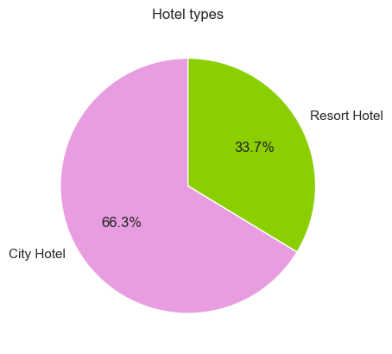
INTRODUCTION
This data set contains booking information for city hotel and a resort hotel, and includes information such as when the booking was made, length of stay, the number of adults, children, and/or babies, and the number of available parking spaces, among other things.
All personally identifying information has been removed from the data.
More About the Data and its source:
Each row is a booking so questions will revolve around answering or predicting what are the possible behaviour and features of the booking given a set of input features.

Slide 4
OUR PYDATA STACK
NUMPY
PANDAS
MATPLOTLIB
SEABORN
PLOTLY
SCIKIT LEARN

Slide 5
ABOUT DATA
Categorical
Ordinal / Numerical
hotel
meal
country
market_segment
distribution_channel
reserved_room_type
assigned_room_type
agent
country
customer_type
reservation_status_date
name
email
phone_number
credit_card
is_cancelled
lead_time
arrival_date_year
arrival_date_week_number
arrival_date_month
stays_in_week + weekend_nights
adults
children
babies
is_repeated_guests
previou_cancellations
previous_bookings_not_cancelled
booking_changes
company
agent
days_in_waiting_list
adr
required_car_parking_spaces
total_of_requests

Slide 6
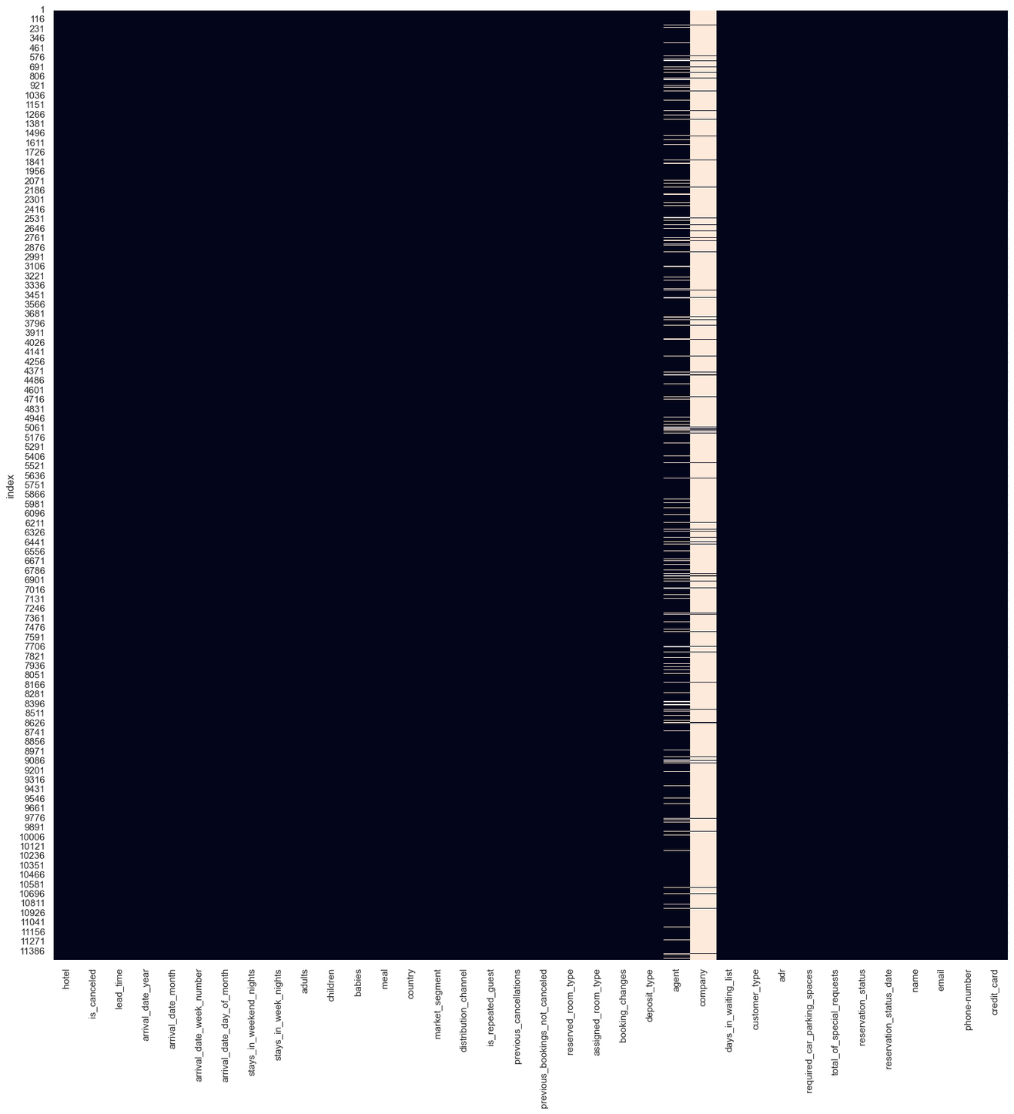

Slide 7
WHY IS THERE EMPTY VALUES ???

Slide 8
EDA
James Mccann reserved a room in Resort Hotel for 10.03.2016 which is a Thursday, where, James reserved 219 days before, i.e, 04.08.2015, where James is going to stay until Wednesday and leaves on 17.03.2016. James is acompanied by another 1 more Adults and James is from Portugal, which means he is a Transient customer type under the market_segment Offline TA/TO with the distribution channel of the same TA/TO. James has an ADR of 52.0, so if we calculate assuming in James spent 52.0 x 7= 364.4
James is a first time customer as his previous bookings as well as previous cancellations are both zero. He unfortunately canceled his stay. James reserved the "A" room type and the hotel assigned the "A" room type. There is a non-refund and he used Agent 310.0. James had 0 special requests. James also had a HB meal
Personal Details:
name James Mccann
email James_M@outlook.com
phone-number 927-686-6838
credit_card ************4741

Slide 9
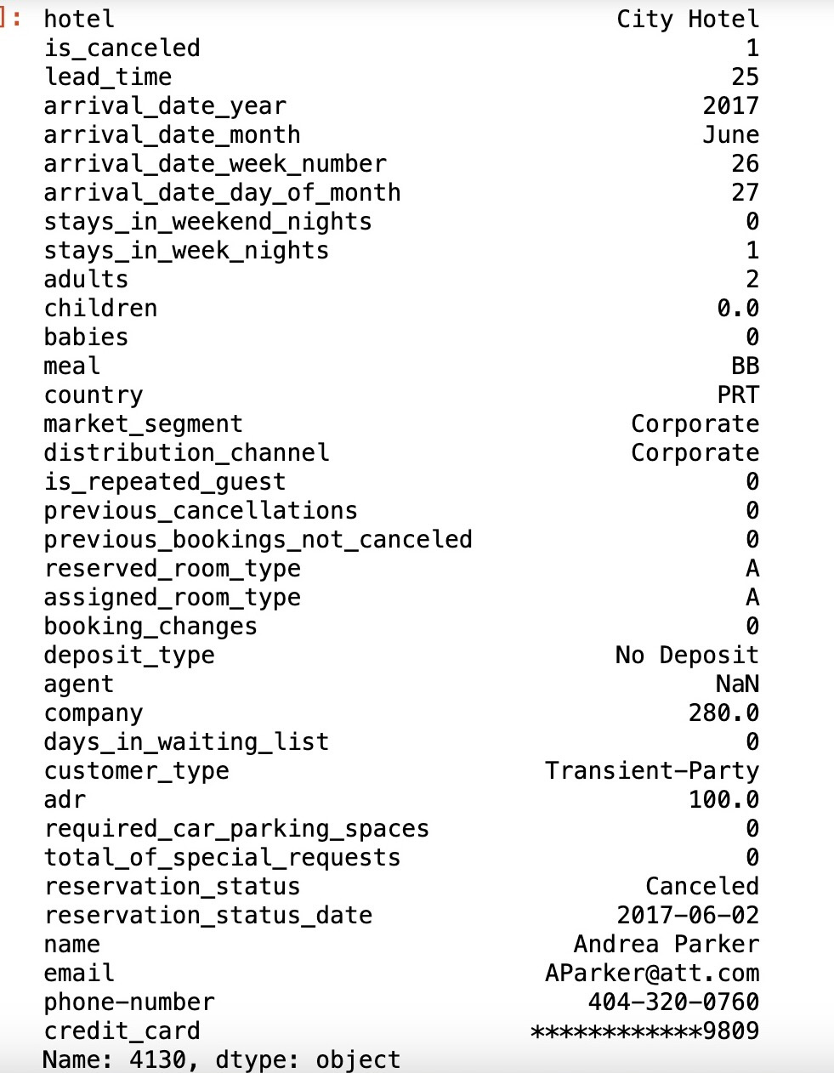
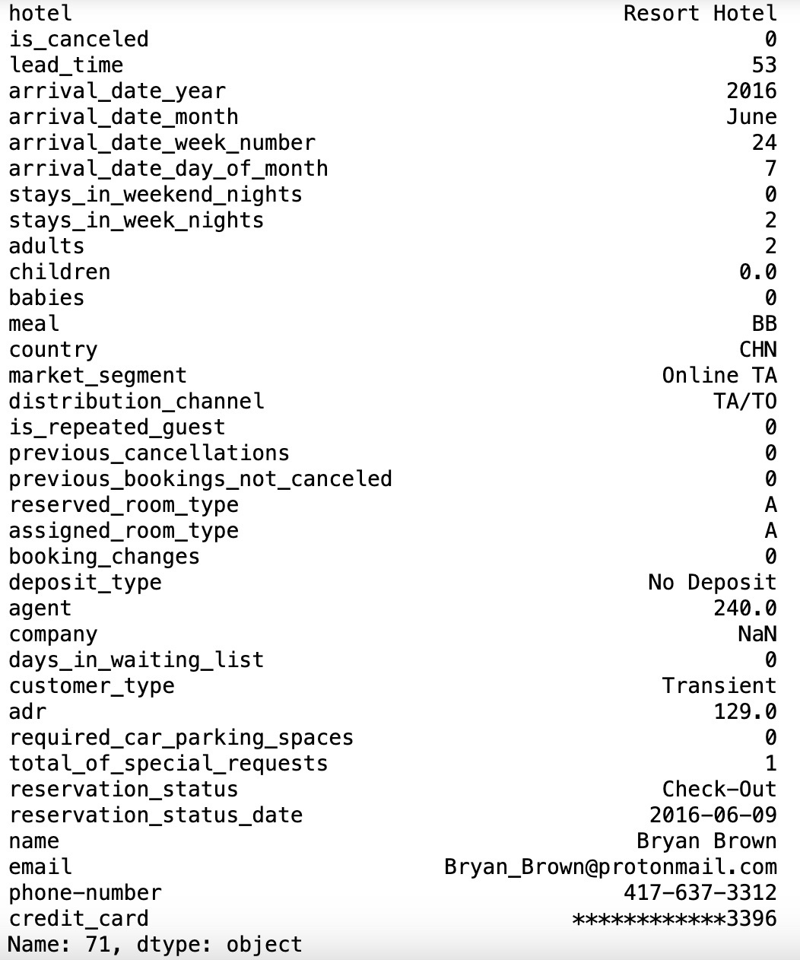

Slide 10
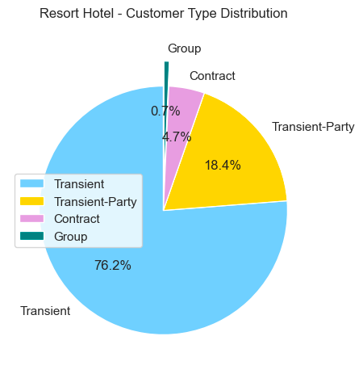
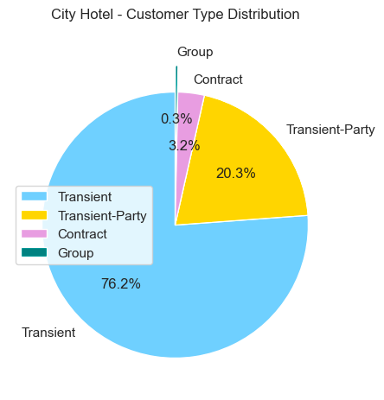
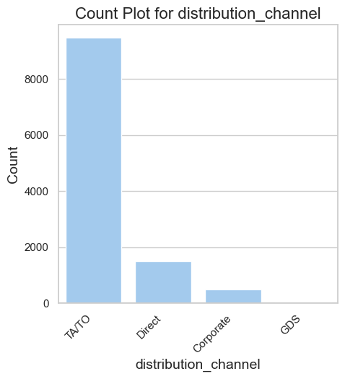

Slide 11
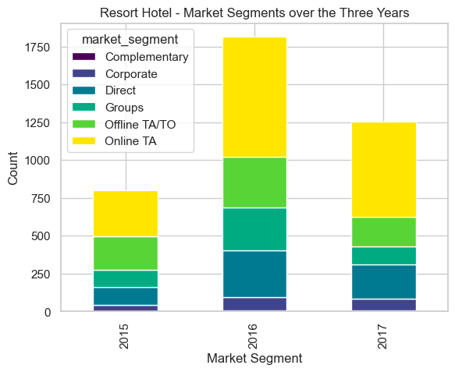
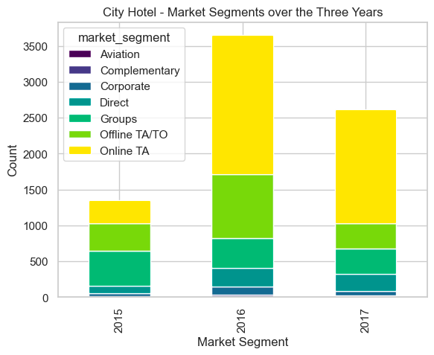

Slide 12
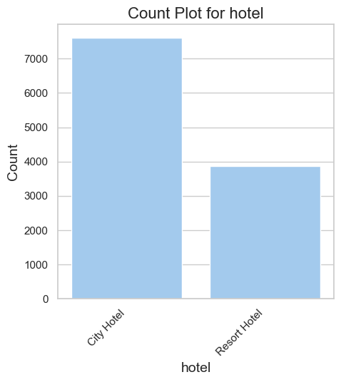

Slide 13
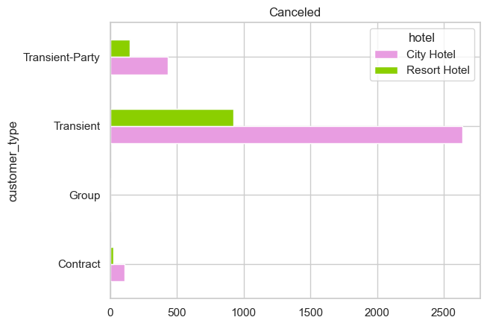
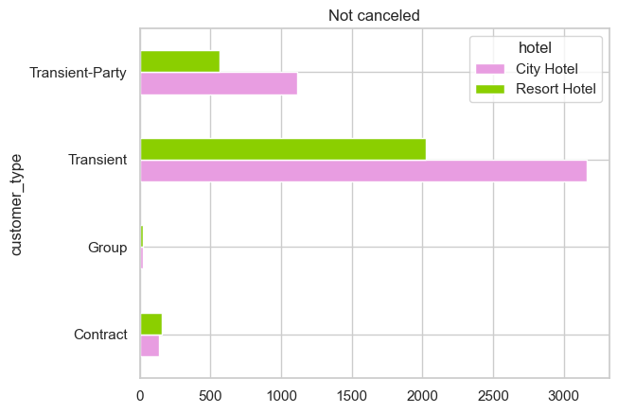
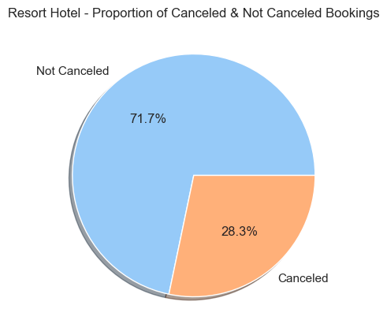
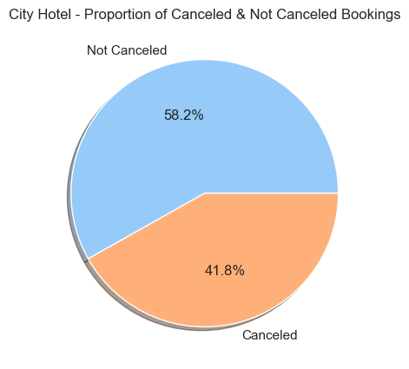

Slide 14
INFERENCE FORM OUR EDA
# 1 WHEN WILL THE CUSTOMER CANCEL A BOOKING
Are there any specific Parameters to look for ?
Is it the Price ?
Or is there something else...

Slide 15
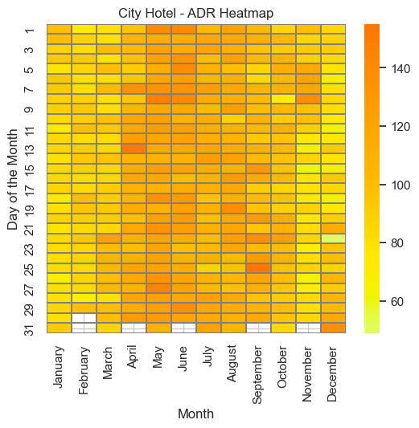
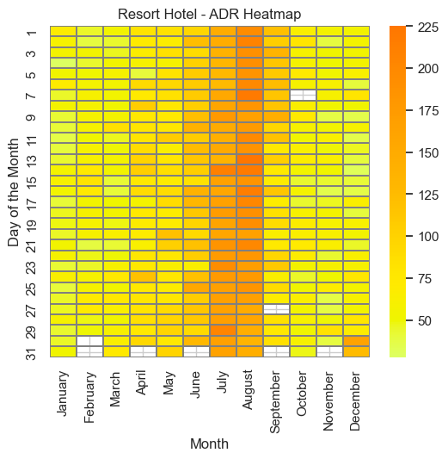

Slide 16
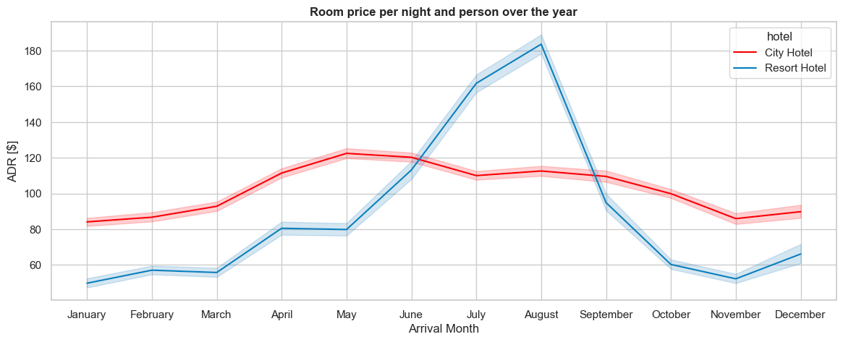
[EUR]

Slide 17
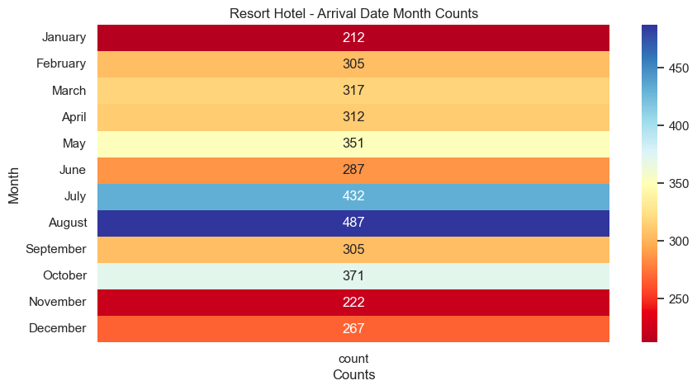
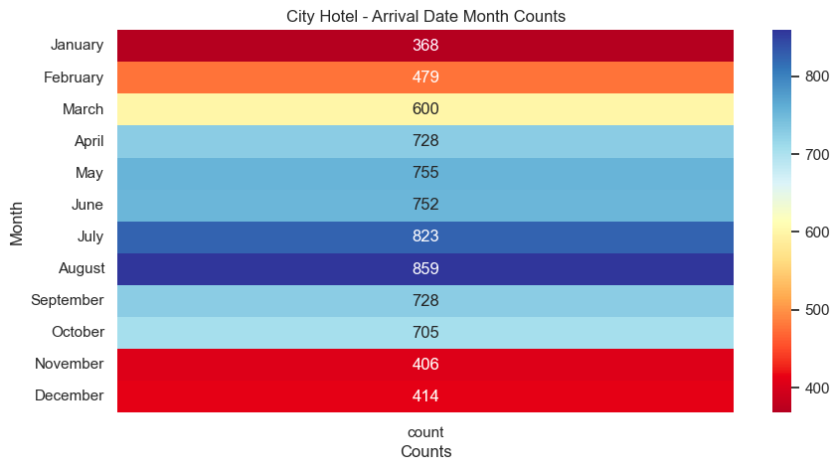

Slide 18
#3 Classification and Regression

Slide 19
CLASSIFICATION
FEATURE SELECTION
BUILDING THE MODEL
EVALUATING THE MODEL
OPTIMIZING MODEL PERFORMANCE

Slide 20
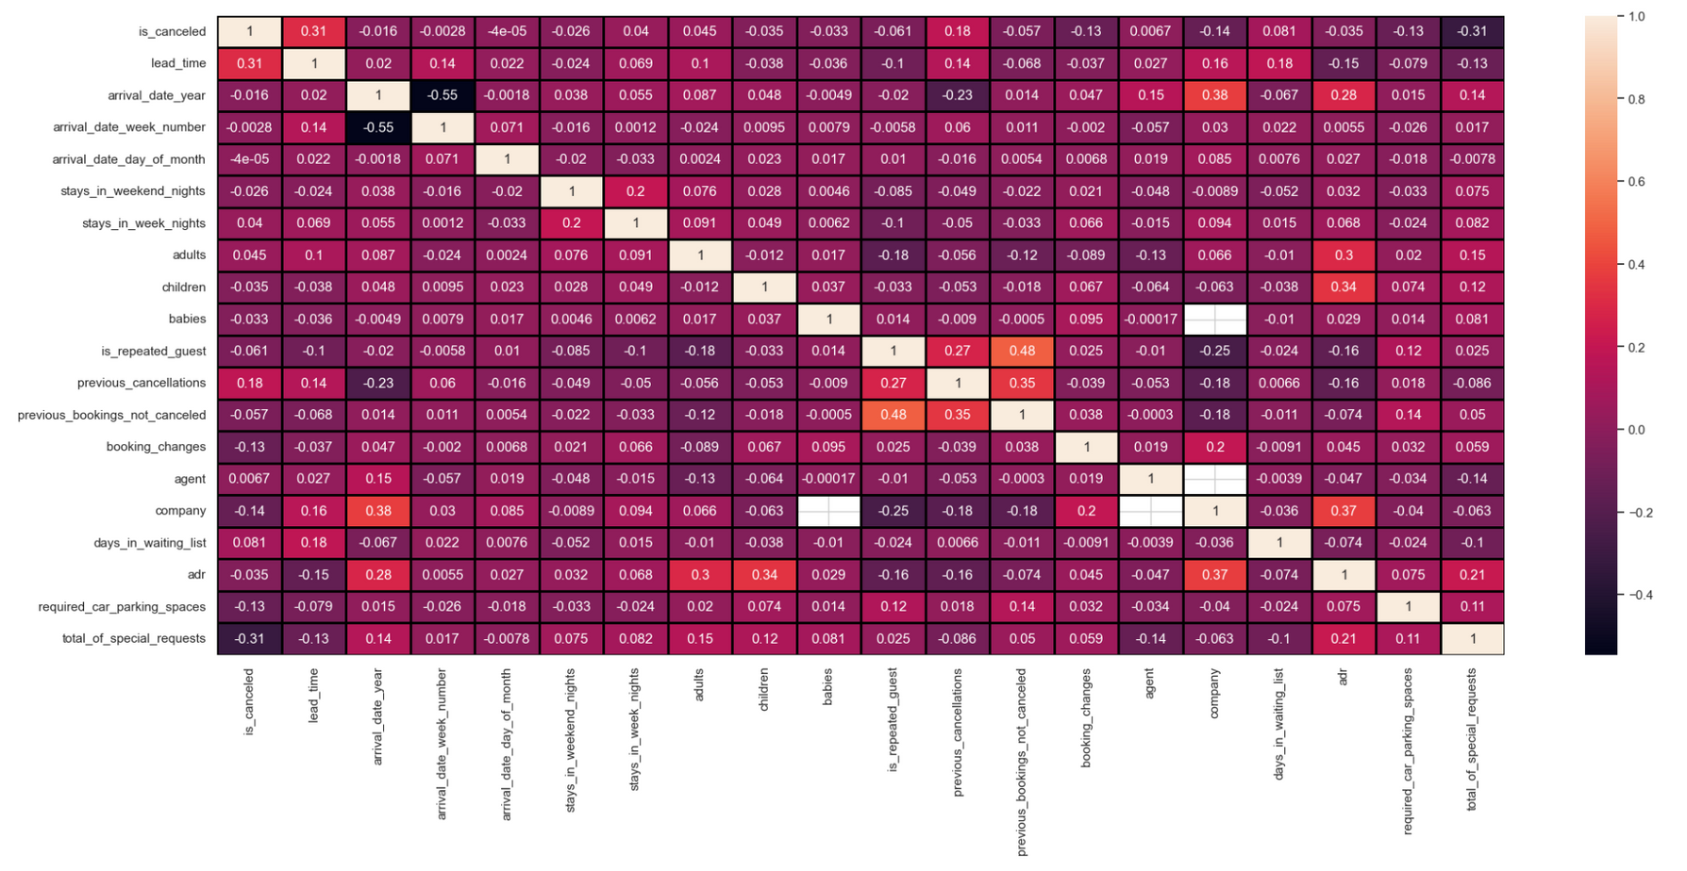
CITY
Positive Correlation
Weak Positive Correlation
Weak Positive to Very Weak Positive Correlation
Features with Little Correlation

Slide 21
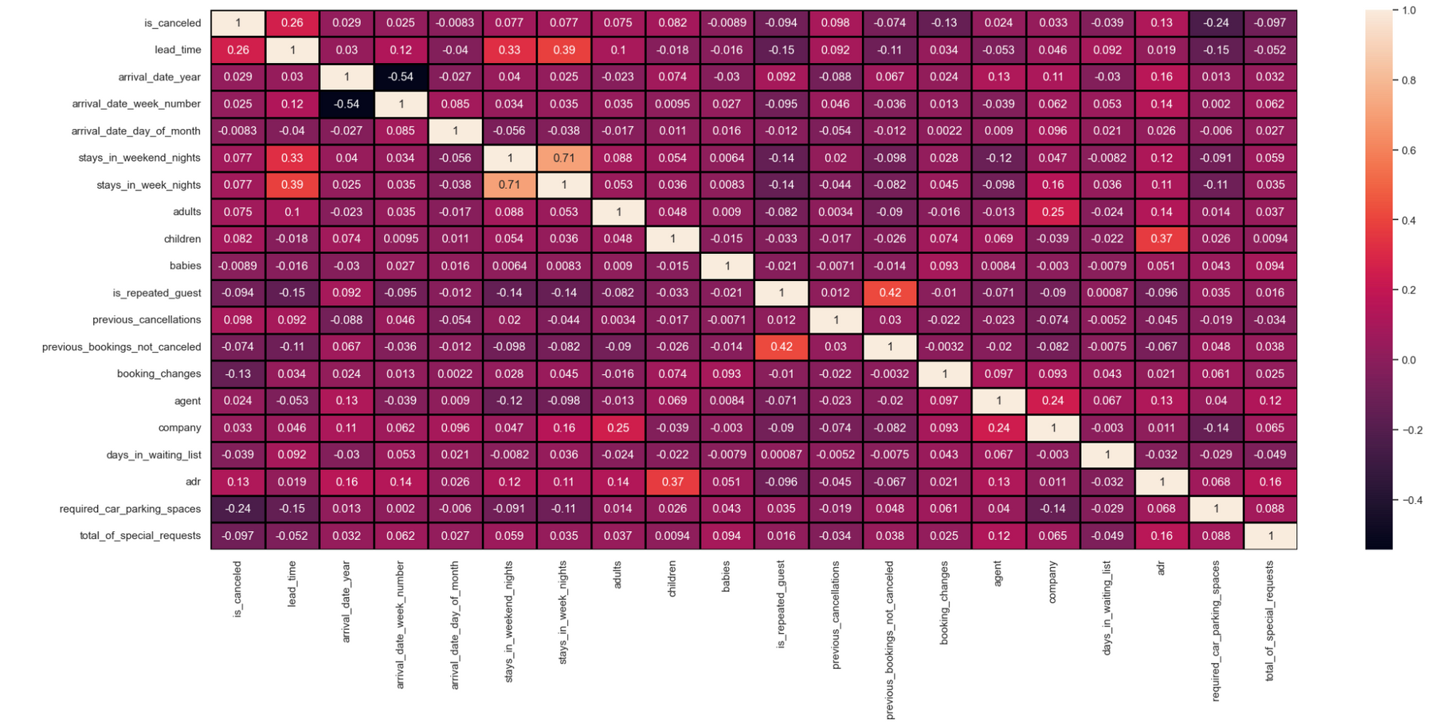
RESORT
Positive Correlation
Weak Positive Correlation
Weak Positive to Very Weak Positive Correlation
Features with Little Correlation

Slide 22
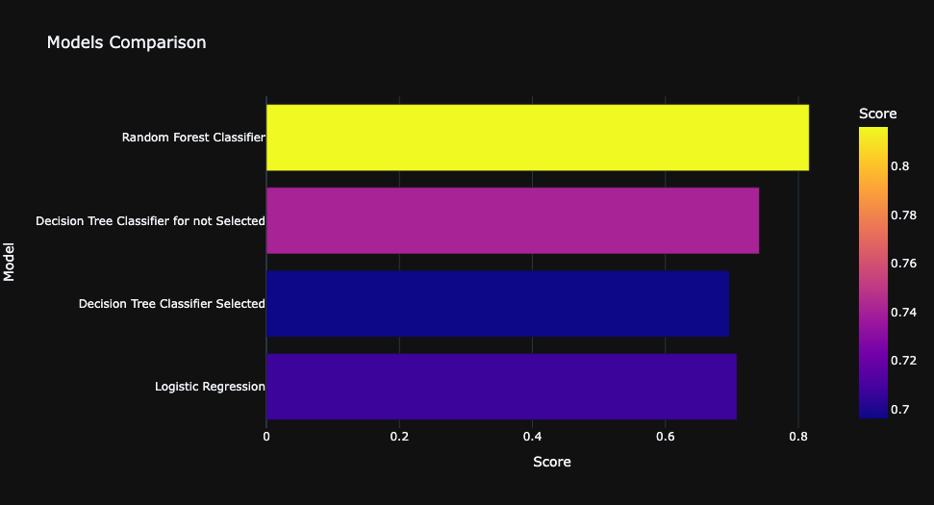
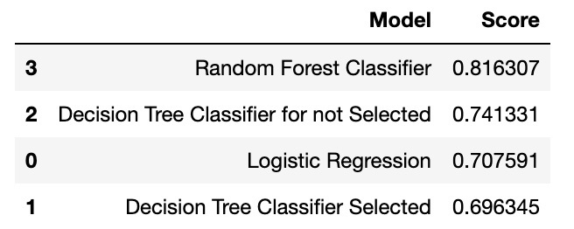
CITY

Slide 23
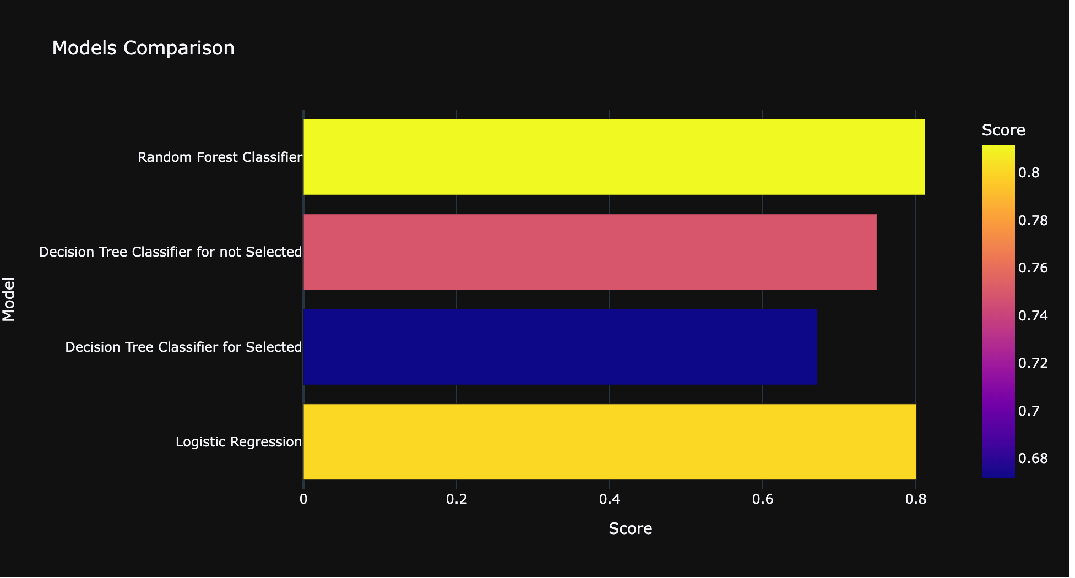
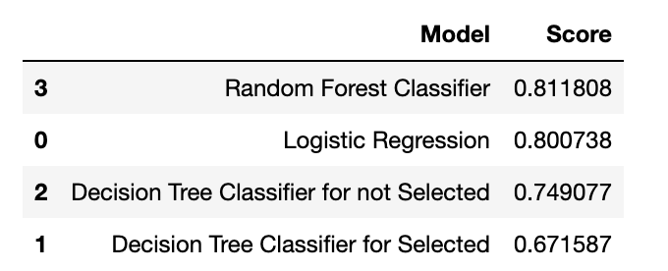
RESORT

Slide 24
1. Logistic Regression:
- Purpose: Logistic Regression is like a simple and interpretable tool designed for binary decisions. It predicts the probability of an event happening (like a customer making a purchase), and then converts this probability into a clear decision (yes or no).
- When to use: Use Logistic Regression when dealing with two possible outcomes and you want a straightforward understanding of how different factors influence the likelihood of an event.
2. Decision Tree:
- Purpose: Imagine a series of yes/no questions that lead you to a decision. Decision Trees work similarly. They ask questions about the data (e.g., Is the customer new? Did they make a purchase before?), creating a flowchart-like structure to make a final decision.
- When to use: Decision Trees are useful when your decision-making process involves a sequence of criteria, and you want a model that can capture complex patterns in your data.
3. Random Forest Classifier:
- Purpose: Think of Random Forest as a group of friends giving you advice. Instead of relying on just one person's opinion (Decision Tree), you ask multiple people (many Decision Trees) and combine their advice. This ensemble approach often results in a more reliable decision.
- When to use: If you're concerned about one "expert" (Decision Tree) making mistakes, Random Forest helps by considering various perspectives. It's especially useful when you have many features or complex relationships in your data.

Slide 25
i. Cross-validation for Logistic Regression and RandomForestClassifier:
Purpose:
Provides a more robust estimate of a model's performance by splitting the dataset into multiple folds, training the model on different subsets, and evaluating on the remaining data.
Why:
Helps in assessing how well the model generalizes( make accurate predictions on data it hasn't been explicitly trained on) to unseen data and reduces the risk of overfitting or underfitting.

Slide 26
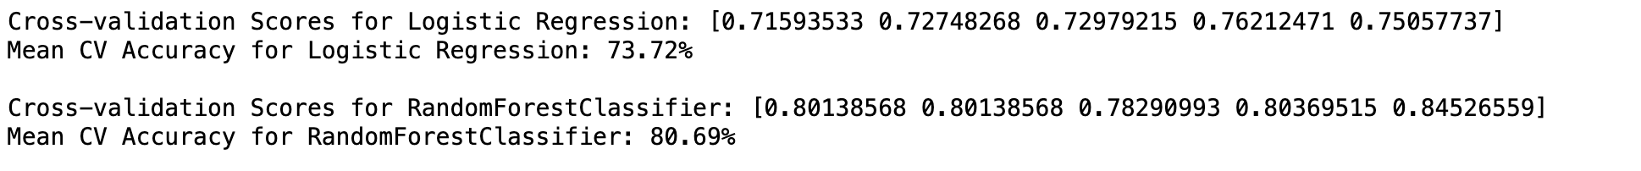
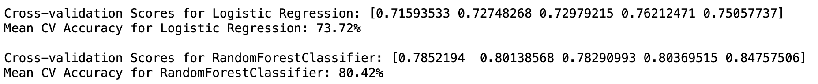
CITY
RESORT

Slide 27
ii. Receiver Operating Characteristic (ROC) Curve for Logistic Regression:
Purpose:
Evaluates the trade-off between true positive rate and false positive rate across different probability thresholds.
Why:
Particularly useful for binary classification problems to assess the model's ability to discriminate between the positive and negative classes. The Area Under the ROC Curve (AUC-ROC) provides a summary measure of the model's performance.

Slide 28
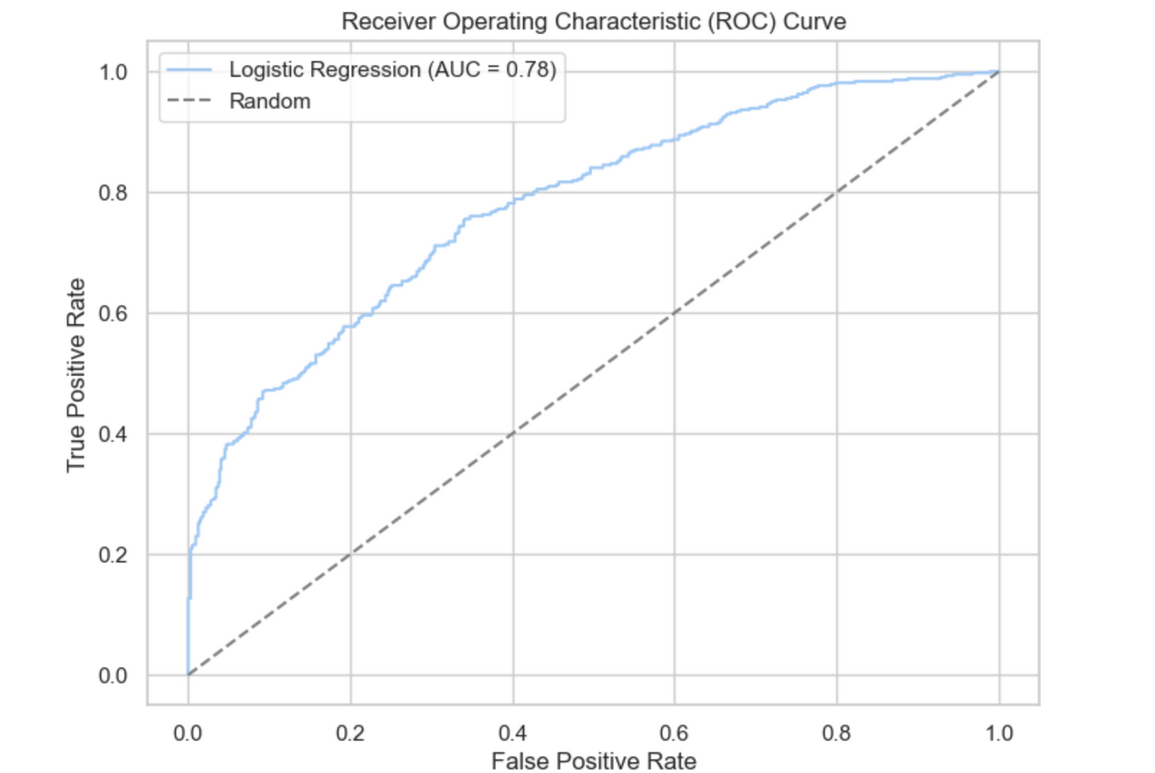
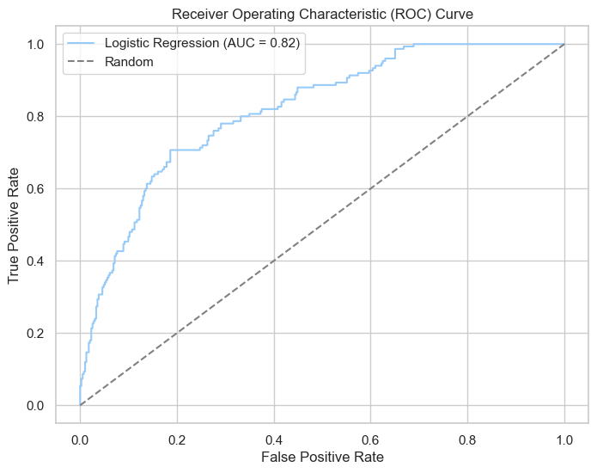
CITY
RESORT

Slide 29
iii. Hyperparameter Tuning using GridSearchCV for DecisionTreeClassifier:
Purpose:
Searches for the best combination of hyperparameters to optimize the model's performance.
Why:
Helps in fine-tuning the model to achieve better predictive accuracy and generalization. Hyperparameter tuning is crucial for improving a model's performance beyond default settings.

Slide 30
CITY
RESORT

Slide 31
#4 Predicting Average Daily Rate to improve sales

Slide 32
Regression Modelling to predict the Average Daily Rate
1) FEATURE ENGINEERING
2) BUILDING THE MODEL
3) EVALUATING THE MODEL
4) OPTIMIZING MODEL PERFORMANCE

Slide 33
What is the ADR a customer is ready to pay?
Feature Engeneering:
Selected a set of 13 features which was correlating linearly.
Performed basic information search found out that these 13 input variables would effect the predicting Average Daily Rate (ADR) of the product.
Correlation and Impact: The features selected for predicting ADR were determined based on a thorough correlation analysis, ensuring that each feature has a statistically significant relationship with the room rates, and therefore, directly impacts revenue optimization strategies.
Comprehensive Coverage: The chosen features provide a comprehensive view of booking dynamics, including room types, guest composition, booking timeframes, and special requests, reflecting both customer preferences and operational factors that influence pricing.
Temporal Insights: Features such as arrival_date_year and arrival_date_month capture seasonal trends and yearly market changes, offering valuable insights for adjusting pricing strategies in response to demand fluctuations over time.

Slide 34
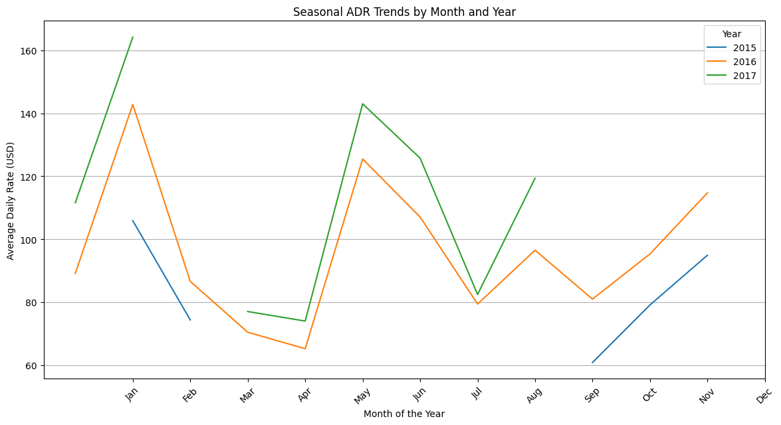

Slide 35
Encoding the Data
In this step, we transformed categorical data into a numerical format using Label Encoding, assigning a unique integer to each category within the features, which is necessary for the machine learning algorithms to process the input data effectively.
This encoding method maintains the categorical nature of the data while preparing it for the correlation analysis and subsequent modeling.

Slide 36
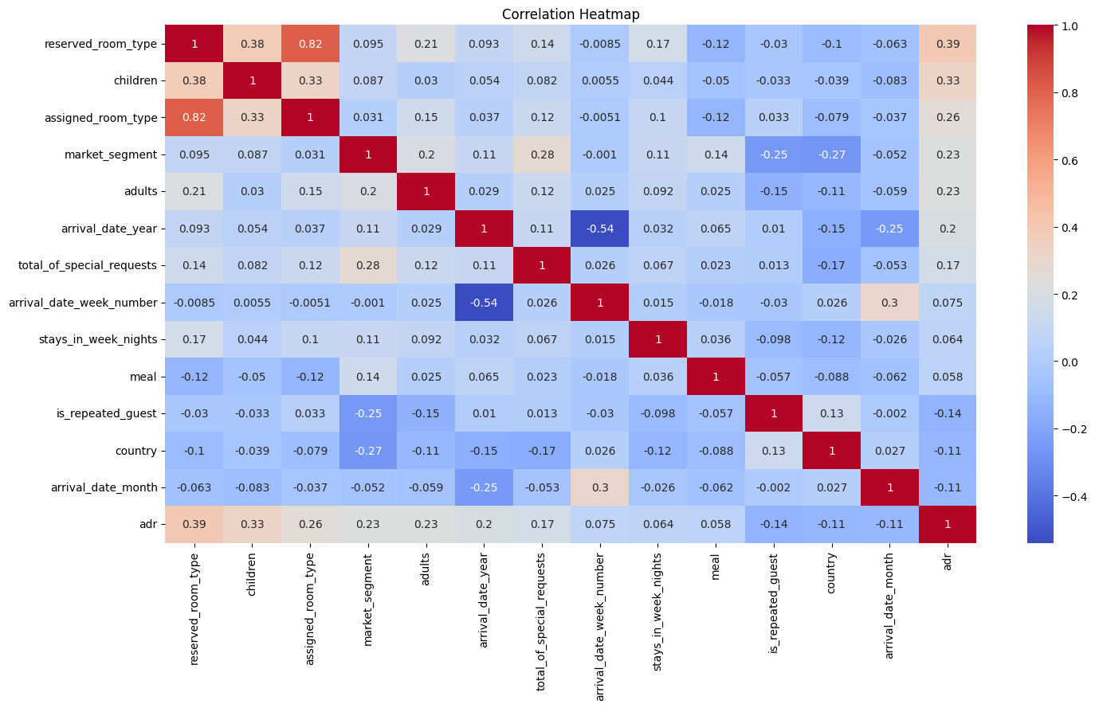

Slide 37
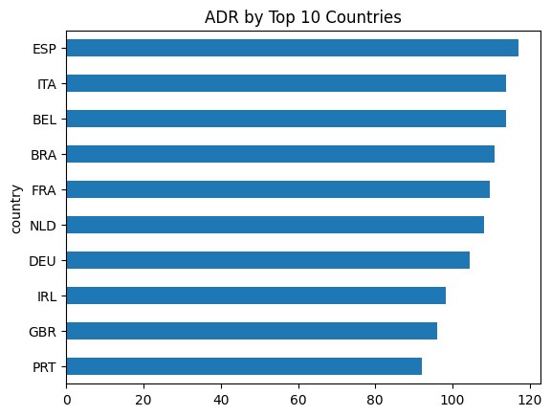
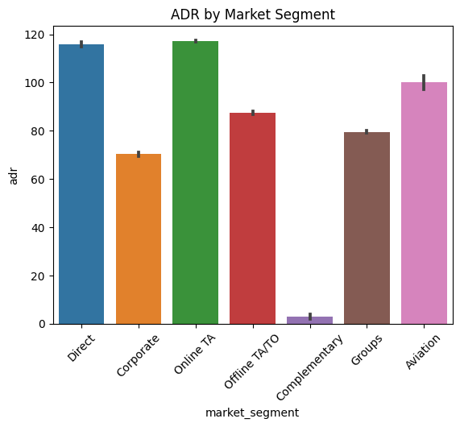
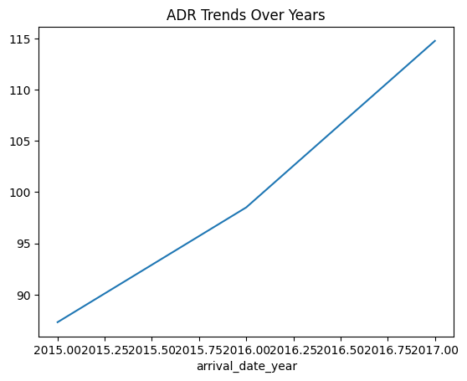

Slide 38
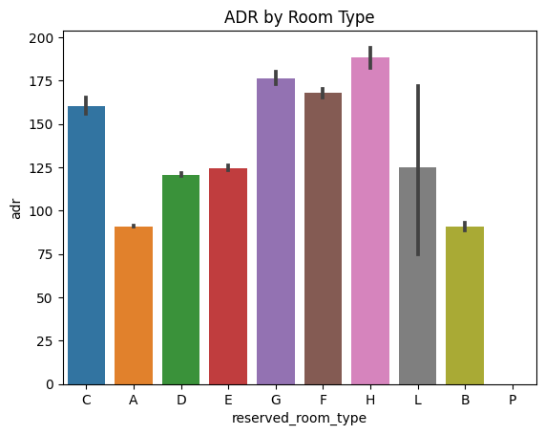
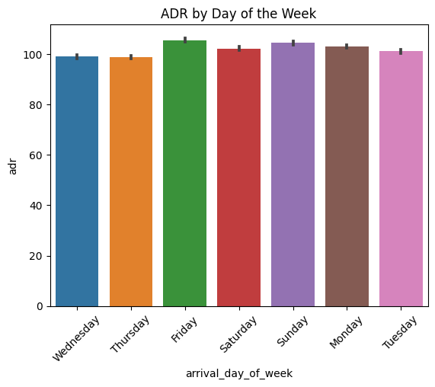

Slide 39
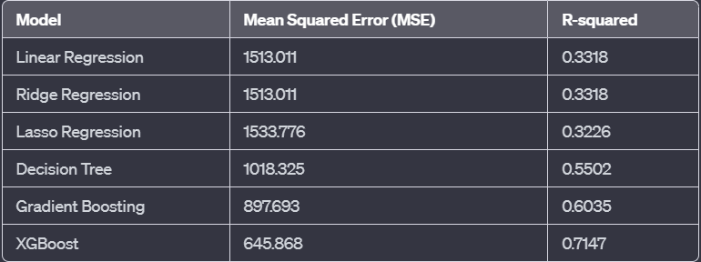
Choosing the Best
Model

Slide 40
hyperparameter tuning with GridSearchCV
Executed a comprehensive grid search cross-validation with 81 unique combinations across 3 folds, totaling 243 fits to identify the optimal model settings.
Optimal Model Parameters Identified:
Learning Rate: 0.2
Max Depth: 7
Number of Estimators: 200
Subsample: 0.9
Next we performed some Cross-Validation with the best parameters from the grid search to perform cross-validation.
Cross-Validation Scores: [0.52737422 0.61701214 0.18137931 0.43330826 0.40936078]
Mean R-squared: 0.4336869425512229
Standard Deviation: 0.14603868246303464

Slide 41
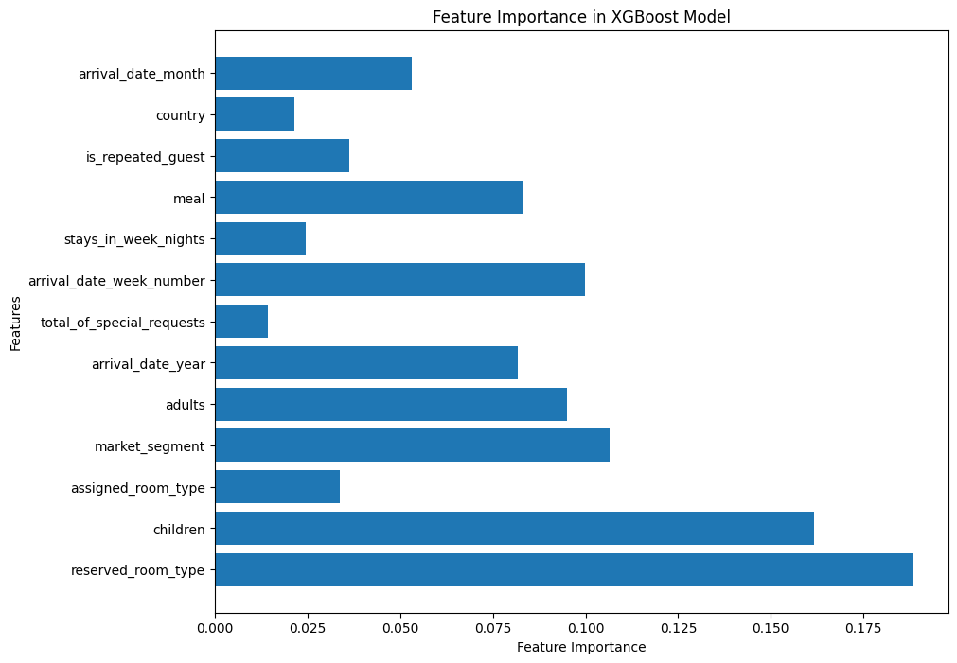

Slide 42
Feature Importance Visualization:
From the bar chart, it appears that reserved_room_type and children are among the most important features in predicting ADR, followed by assigned_room_type, market_segment, and adults. This aligns with intuitive understanding—room types and the number of occupants can significantly influence the room rate.
Key Observations:
The feature importance chart is a critical tool for understanding which features most strongly influence the ADR. It can inform decision-making regarding pricing strategies and targeted marketing. The difference in feature importance suggests that focusing on room types and catering to specific market segments or family compositions could be effective strategies for revenue optimization.

Slide 43
WHAT WE LEARNT
To check the validity and source of the data.
Understand the data with respect to each instance without any tools
Establish and infer a pattern from basic EDA
Delve into depth EDA after pattern recognition

Slide 44


